Slide 1
Computer Organization Principles
School of Software, Dalian University of Technology
Chi Lin (林驰)
chilin@mail.dlut.edu.cn

Slide 2
Chapter 2
Overview of Computer Science Systems
Contents
  OS Brief Overview
  Compiler
  Principles of Computer Systems Architecture
  Course Importance & Meaning

Slide 3
Chapter 2
Overview of Computer Science Systems
Contents
  OS Brief Overview
  Compiler
  Principles of Computer Systems Architecture
  Course Importance & Meaning

Slide 4
OS Brief Overview
What ?
  A program that acts as an intermediary between a user of a computer and the computer hardware.
Why ?
  Execute user programs and make solving user problems easier.
  Make the computer system convenient to use.
Who ?
  Users, developers, .etc.
How ?
  Use the computer hardware in an efficient manner.

Slide 5
OS Definition
An operating system (OS) is software that manages computer hardware and software resources and provides common services for computer programs. The operating system is an essential component of the system software in a computer system. Application programs usually require an operating system to function.

Slide 6

Computer System Components
Hardware
OS
Applications
Users

Slide 7
OS Components
Kernel
Program execution
Interrupts
Modes
Memory management
Virtual memory
Multitasking
Disk access and file systems
Device drivers
Networking
Security
User interface
Graphical user interfaces

Slide 8
Operating System Virtual Machine (OSVM)
M4 (HLVM)
Software
M3 (ALVM)
M2 (OSVM)
M1 (AM)
Hardware
M0 (MM)
OS: Manage hardware, provide user interfaces for low level machine

Slide 9

Migration of Operating-System Concepts and Features

Slide 10
System Functionality
Process Management
Memory Management
Device Management
File Management
User Interface

Slide 11
Process Management
Process control
Process scheduling
Process synchronization
Process communication

Slide 12
Memory Management
  Memory Control
  Memory Protection
  Memory Mapping
  Memory Expansion

Slide 13
Device Management
  Device Operation
  Virtual Devices
  Cache Management

Slide 14
File Management
  File Storage Management
  Directory Management
  Read/Write Manage
  Storage Control

Slide 15
User Interface
  System Command
  Programmable Interface
  Graphical Interface

Slide 16
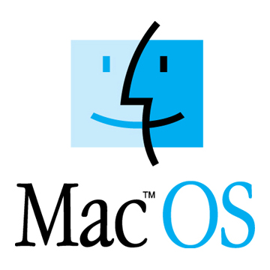
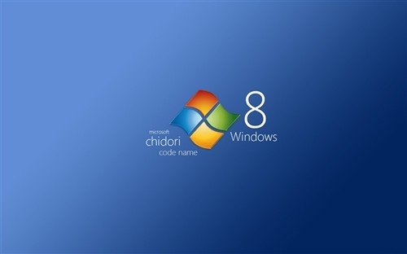

Desktop Systems

Slide 17
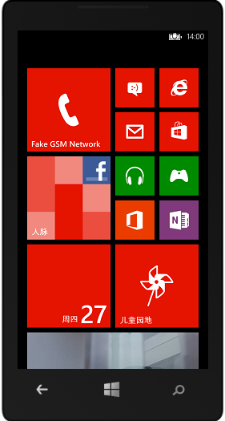


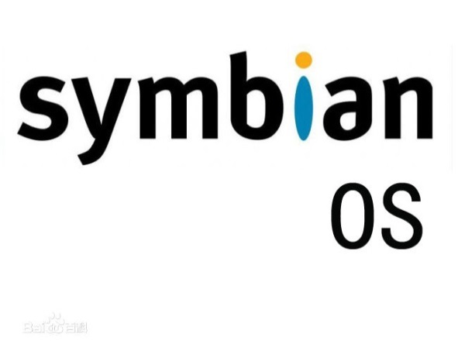
Handheld Systems

Slide 18

Typical Embedded Operating System
µC/OS-II
VxWorks
WinCE
Linux

Slide 19
µC/OS-II
Advantages: Open Source (开源), Tiny Structure（结构小巧）, Cuttable (可裁剪) , Preemptive(可抢占), Real time（实时）
High efficiency, small size, high portability(高可移植性)
64 Tasks are supported, with priority 0~63.
Developed by ANSI C, successfully transplanted on nearly 40 different kinds of processors.

Slide 20
WinCE OS
Multi-threads(多线程)、Multi-tasks(多任务)
High-modularity, useful for customizing from PC to controller.
Graphical Interface(图形界面)
Portable

Slide 21
Chapter 2
Overview of Computer Science Systems
Contents
  OS Brief Overview
  Compiler
  Principles of Computer Systems Architecture
  Course Importance & Meaning

Slide 22
Compiler
A compiler is a computer program (or set of programs) that transforms source code written in a programming language (the source language) into another computer language (the target language, often having a binary form known as object code).
The most common reason for wanting to transform source code is to create an executable program.

Slide 23
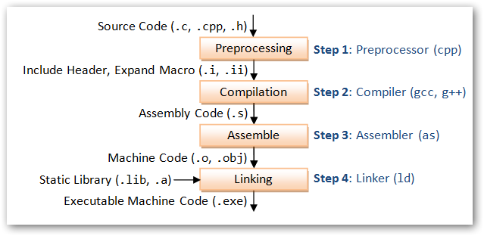
Compiling Process

Slide 24
Preprocessing
gcc -E test.c -o test.i or gcc -E test.c
可以输出test.i文件中存放着test.c经预处理之后的代码。打开test.i文件，看一看，就明白了。后面那条指令，是直接在命令行窗口中输出预处理后的代码.
gcc的-E选项，可以让编译器在预处理后停止，并输出预处理结果。在本例中，预处理结果就是将stdio.h 文件中的内容插入到test.c中了。

Slide 25
Compilation
gcc -S test.i -o test.s
gcc的-S选项，表示在程序编译期间，在生成汇编代码后，停止，-o输出汇编代码文件。

Slide 26
Assembly
gcc -c test.s -o test.o
对于生成的汇编代码文件test.s，gas汇编器负责将其编译为目标文件

Slide 27
Linking
gcc连接器是gas提供的，负责将程序的目标文件与所需的所有附加的目标文件连接起来，最终生成可执行文件。附加的目标文件包括静态连接库和动态连接库。
对于test.o，将其与Ｃ标准输入输出库进行连接，最终生成程序test
gcc test.o -o test
在命令行窗口中，执行./test, 让它说HelloWorld吧！

Slide 28
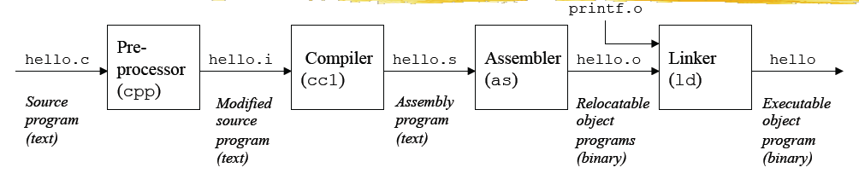

Slide 29
Chapter 2
Overview of Computer Science Systems
Contents
  OS Brief Overview
  Compiler
  Principles of Computer Systems Architecture
  Course Importance & Meaning

Slide 30
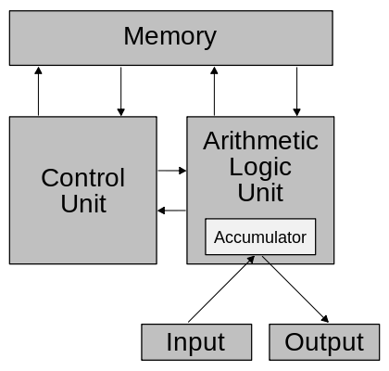
Von Neumann architecture
Memory
Calculator
Control Unit
Input / Output

Slide 31


Memory
Main Memory
Logical Memory
0
Memory
Address
Register
(MAR)
1
2
3
Control
bus
4
Address
bus
…
……
1G-2
1G-1
Memory Data Register (MDR)
Data bus

Slide 32
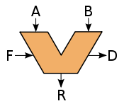
Arithmetic Logic Unit (ALU)
ACC
MQ
In digital electronics, an arithmetic logic unit (ALU) is a digital circuit that performs integer arithmetic and logical operations.
ALU
X
ALU

Slide 33
Control Unit
PC（Program Counter）
CU
IR（Instruction Register）
ID（Instruction Decoder）
ID
PC
IR

Slide 34
A Process of Fetch Data Instruction
CPU
5
Memory
…
ACC
MQ
6
CU
2
7
3
8
I/O
Devices
IR
ALU
Control
Unit
1
PC
MAR
MDR
X
4
ALU
Controller
Main Memory
9

Slide 35
A Process of Data Storage Instruction
CPU
5
Memory
…
ACC
MQ
6
CU
2
7
3
9
I/O
Devices
IR
ALU
Control
Unit
1
PC
MAR
MDR
X
4
ALU
Controller
Main Memory
8

Slide 36
Chapter 2
Overview of Computer Science Systems
Contents
  OS Brief Overview
  Compiler
  Principles of Computer Systems Architecture
  Course Importance & Meaning

Slide 37
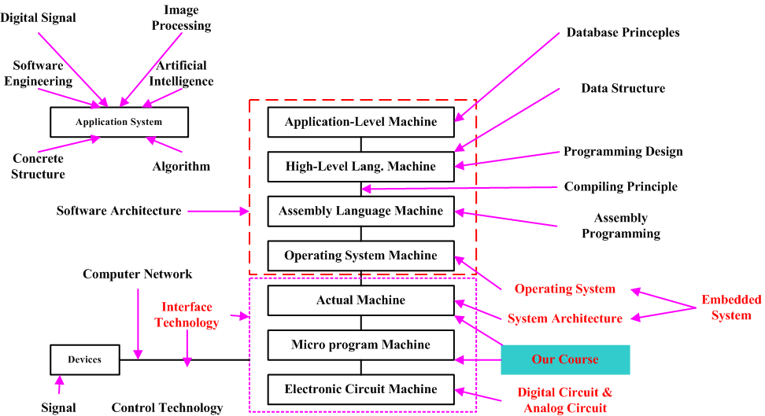
Importance and Meaning

Slide 38
Five Realities for stimulating your interests
Abstraction
Five Realities
  Ints are not Integers, Floats are not Reals
  You’ve Got to Know Assembly
  Memory Matters
  There’s more to performance than asymptotic complexity
  Computers do more than execute programs
Notes:
BEA Confidential

Slide 39
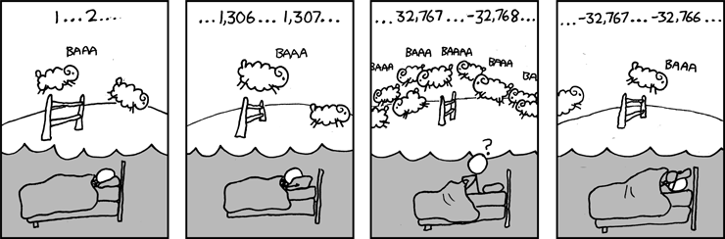
Great Reality #1:
Ints are not Integers, Floats are not Reals
Carnegie Mellon
Example 1: Is x² ≥ 0?
  Float’s: Yes!
  Int’s:
    40000 * 40000 = 1600000000
    50000 * 50000 = ??
Example 2: Is (x + y) + z = x + (y + z)?
  Unsigned & Signed Int’s: Yes!
  Float’s:
    (1e20 + -1e20) + 3.14 --> 3.14
    1e20 + (-1e20 + 3.14) --> ??
Source: xkcd.com/571

Slide 40
Great Reality #2:
You’ve Got to Know Assembly
Carnegie Mellon
Chances are, you’ll never write programs in assembly
  Compilers are much better & more patient than you are
But: Understanding assembly is key to machine-level execution model
  Behavior of programs in presence of bugs
    High-level language models break down
  Tuning program performance
    Understand optimizations done / not done by the compiler
    Understanding sources of program inefficiency
  Implementing system software
    Compiler has machine code as target
    Operating systems must manage process state

Slide 41
Great Reality #3: Memory Matters
Random Access Memory Is an Unphysical Abstraction
Carnegie Mellon
Memory is not unbounded
  It must be allocated and managed
  Many applications are memory dominated
Memory referencing bugs especially pernicious
  Effects are distant in both time and space
Memory performance is not uniform
  Cache and virtual memory effects can greatly affect program performance
  Adapting program to characteristics of memory system can lead to major speed improvements

Slide 42
Memory System Performance Example
Carnegie Mellon
void copyij(int src[2048][2048],
int dst[2048][2048])
{
int i,j;
for (i = 0; i < 2048; i++)
for (j = 0; j < 2048; j++)
dst[i][j] = src[i][j];
}
void copyji(int src[2048][2048],
int dst[2048][2048])
{
int i,j;
for (j = 0; j < 2048; j++)
for (i = 0; i < 2048; i++)
dst[i][j] = src[i][j];
}
21 times slower
(Pentium 4)
Hierarchical memory organization
Performance depends on access patterns
  Including how step through multi-dimensional array

Slide 43
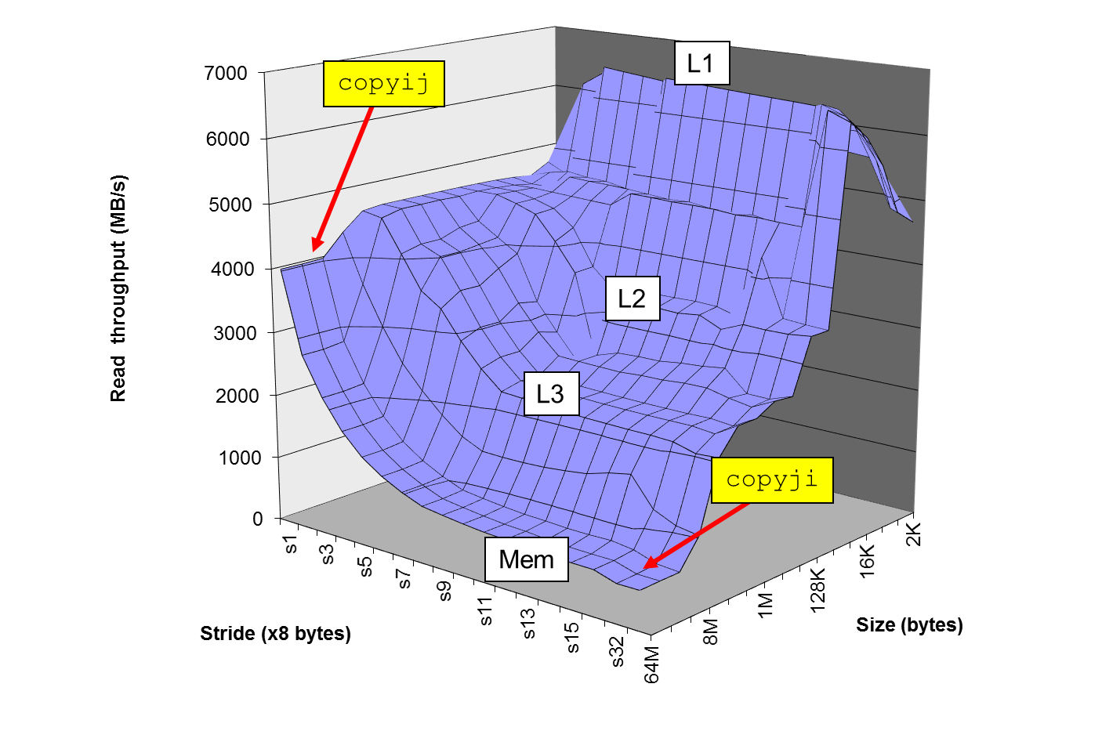
The Memory Mountain
Carnegie Mellon
Intel Core i7
2.67 GHz
32 KB L1 d-cache
256 KB L2 cache
8 MB L3 cache

Slide 44
Great Reality #4: There’s more to performance than asymptotic complexity
Carnegie Mellon
Constant factors matter too!
And even exact op count does not predict performance
  Easily see 10:1 performance range depending on how code written
  Must optimize at multiple levels: algorithm, data representations, procedures, and loops
Must understand system to optimize performance
  How programs compiled and executed
  How to measure program performance and identify bottlenecks
  How to improve performance without destroying code modularity and generality

Slide 45
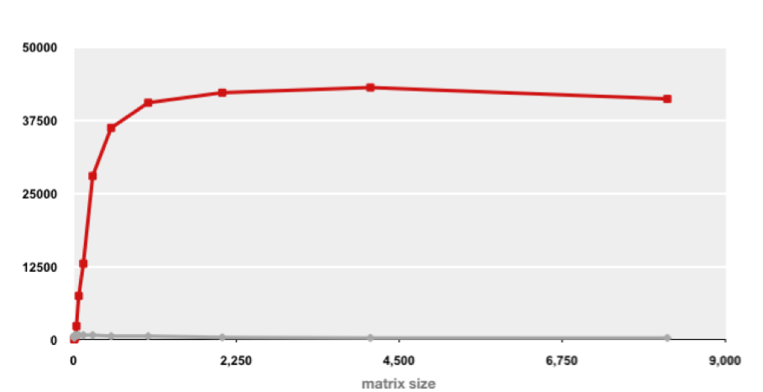
Example Matrix Multiplication
Carnegie Mellon
Matrix-Matrix Multiplication (MMM) on 2 x Core 2 Duo 3 GHz (double precision)
Gflop/s
Best code (K. Goto)
160x
Triple loop
Standard desktop computer, vendor compiler, using optimization flags
Both implementations have exactly the same operations count (2n³)
What is going on?

Slide 46
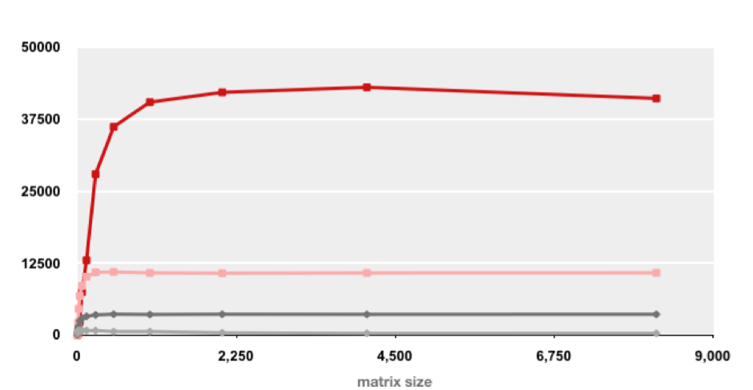
MMM Plot: Analysis
Carnegie Mellon
Matrix-Matrix Multiplication (MMM) on 2 x Core 2 Duo 3 GHz
Gflop/s
Multiple threads: 4x
Vector instructions: 4x
Memory hierarchy and other optimizations: 20x
Reason for 20x: Blocking or tiling, loop unrolling, array scalarization, instruction scheduling, search to find best choice
Effect: fewer register spills, L1/L2 cache misses, and TLB misses

Slide 47
Great Reality #5:
Computers do more than execute programs
Carnegie Mellon
They need to get data in and out
  I/O system critical to program reliability and performance
They communicate with each other over networks
  Many system-level issues arise in presence of network
    Concurrent operations by autonomous processes
    Coping with unreliable media
    Cross platform compatibility
    Complex performance issues

Slide 48
Thank You

